Slide 1
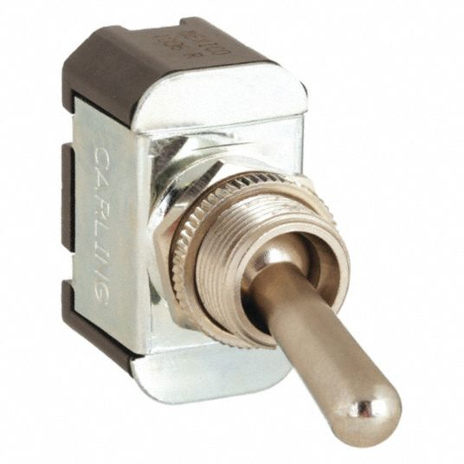

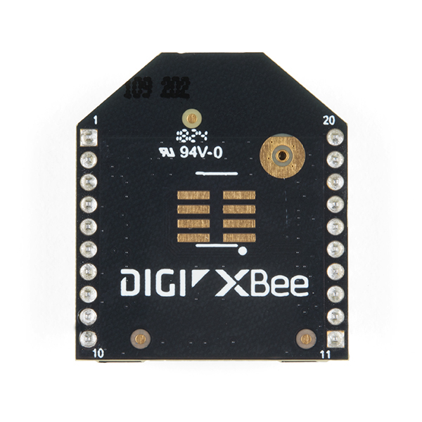
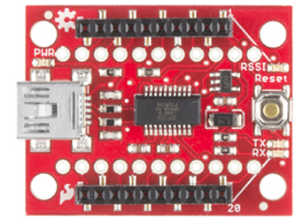
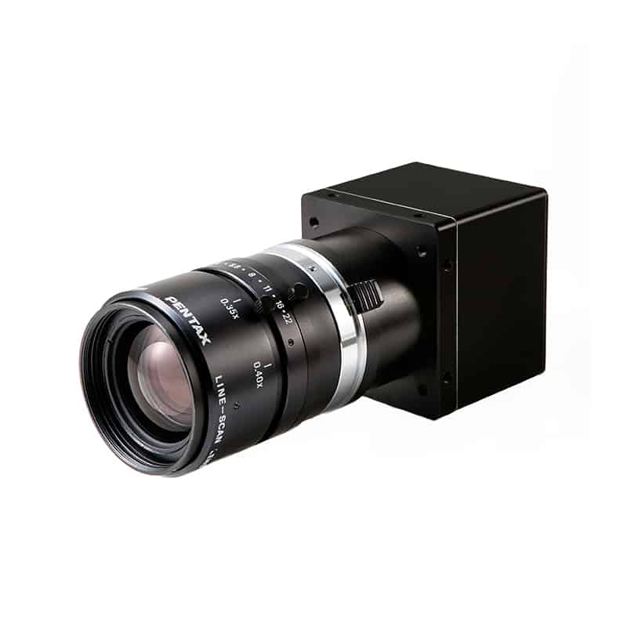
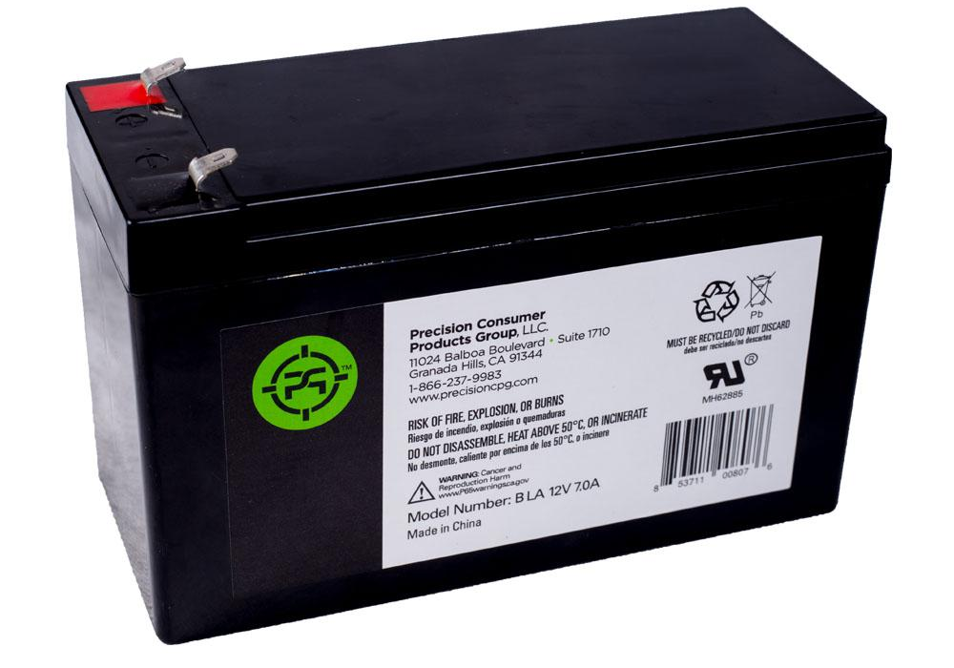
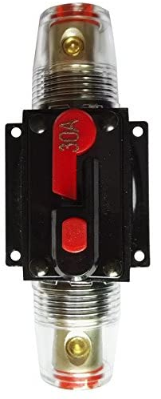
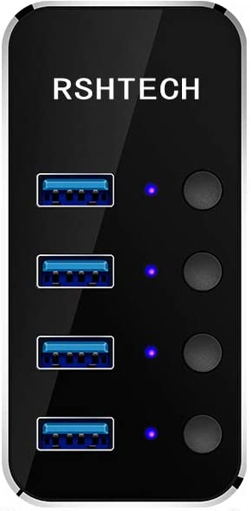
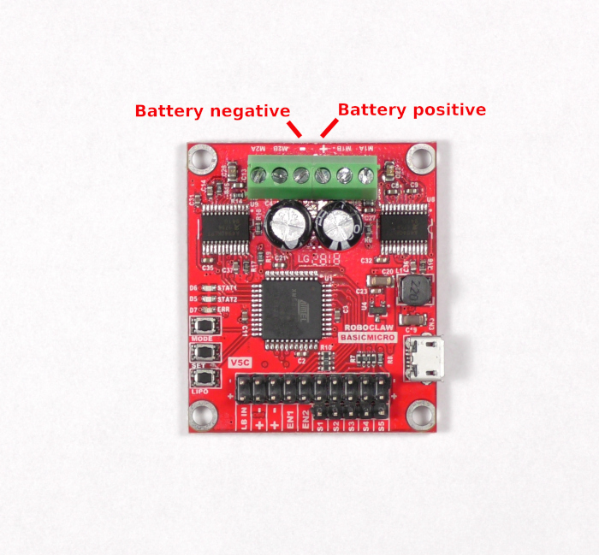
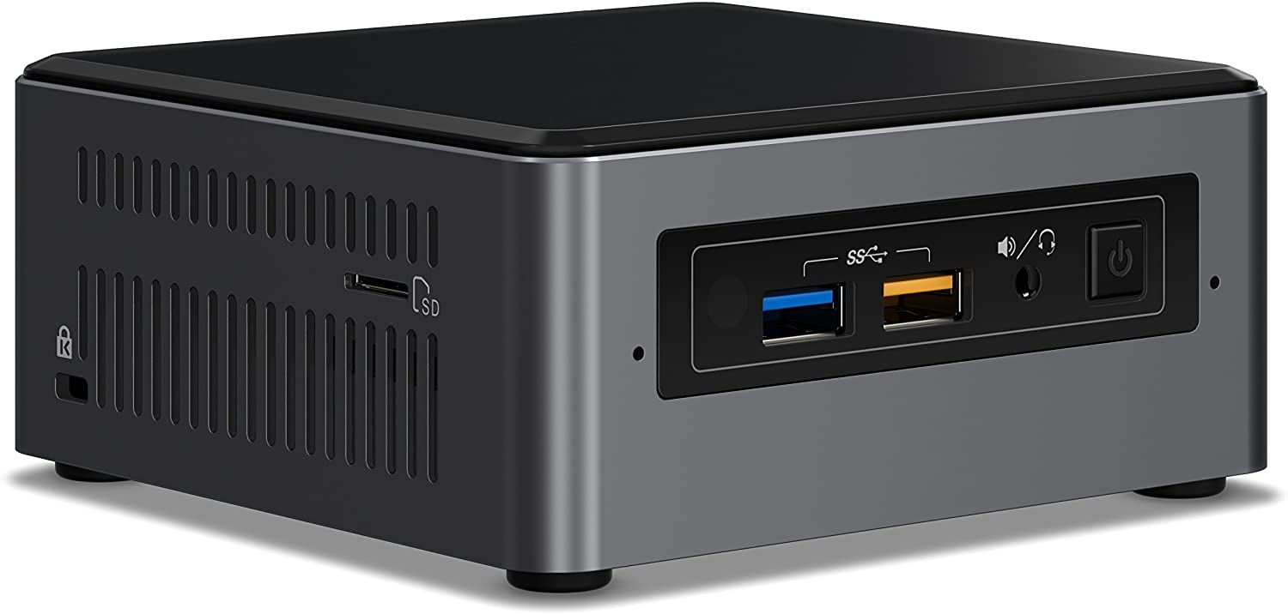
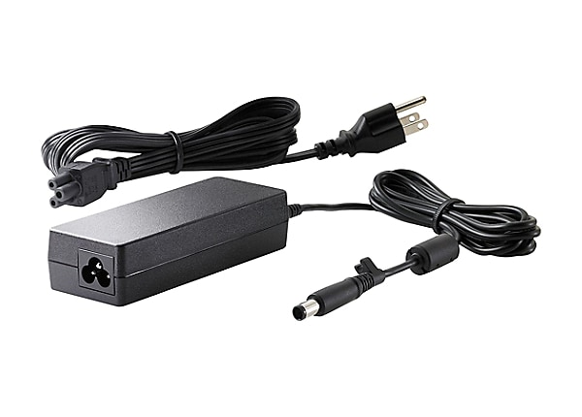
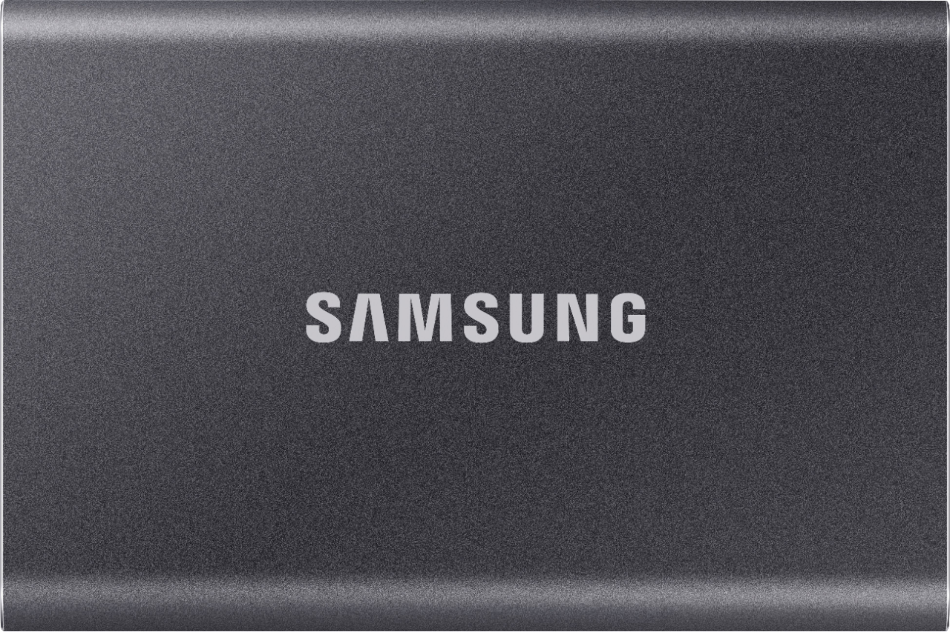
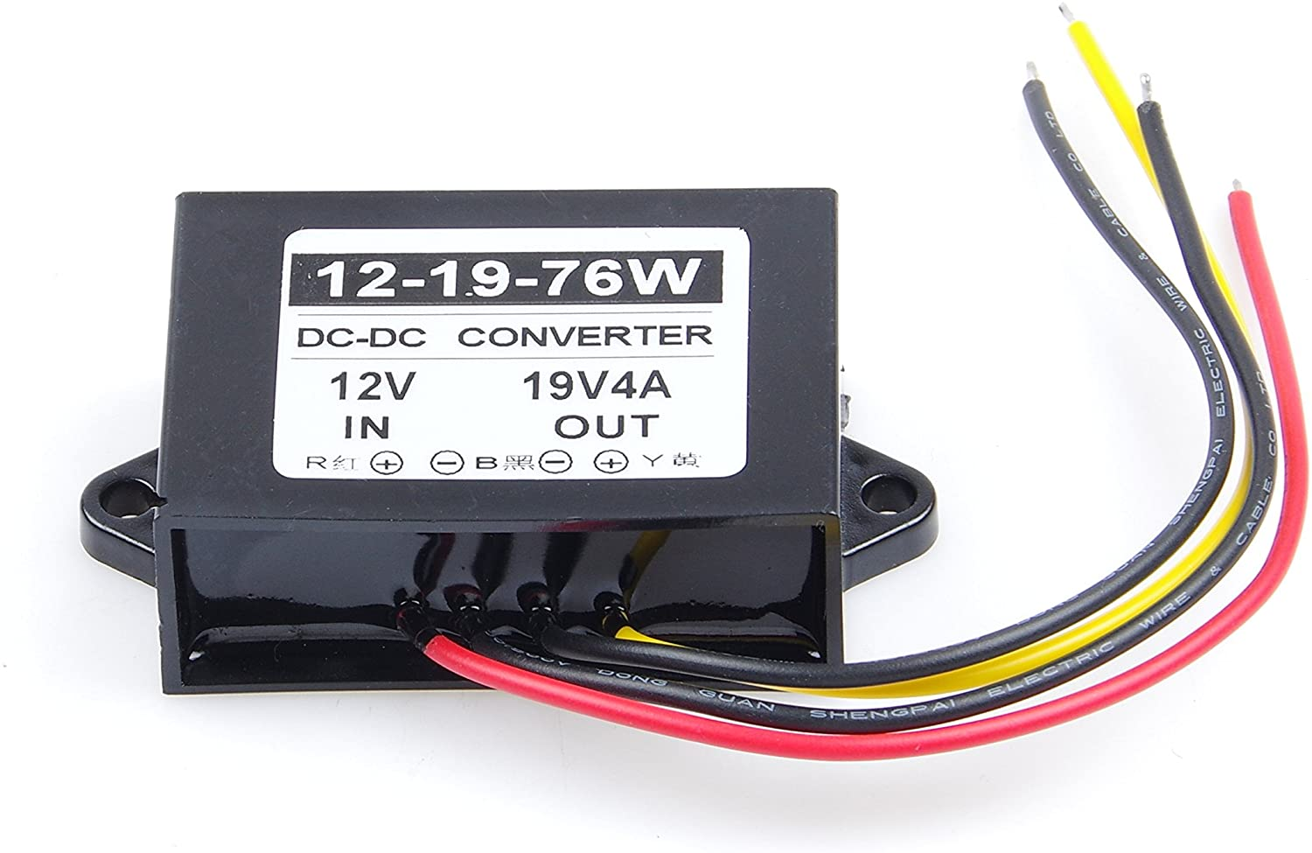
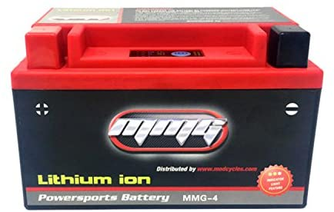
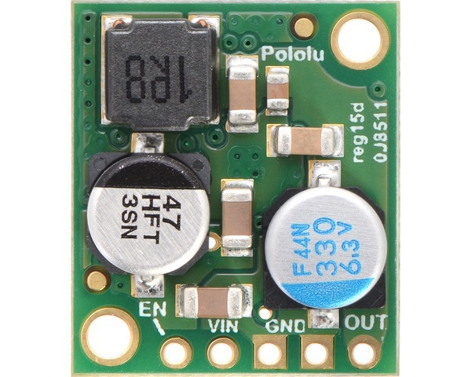
Brobot Electrical diagram
Motor Power Switch
Motor 1 (M1)
Left side
Xbee Series 3
Xbee Explorer USB
30A Fuse
FLIR Camera
En1-
-
En1+
+
M1B
M1A
Two 12 VDC batteries in series
Powered USB Hub
24VDC
Roboclaw
Intel Nuc
En2+
-
M1B
24VDC
En2-
+
M1A
19VDC
5VDC
24 VDC charger
Motor 2 (M2)
Right side
19VDC Step up regulator
USB SSD
12VDC
5VDC Step down regulator
12VDC CPU Battery
12VDC

